Slide 1
Exploring Pandas
Lesson 4.2
Notes:
1.1

Slide 2
Class Objectives
By the end of today’s class you will be able to:
Understand how to navigate through DataFrames using Loc and Iloc.
Understand how to filter and slice Pandas DataFrames.
Understand how to create and access Pandas GroupBy objects.
Understand how to sort DataFrames.
Notes:
1.1
Change notes:
Bold subtitle / looks better
Decrease font from 18 to 17

Slide 3
Exploring Data with Loc and Iloc
Notes:
1.2
Open up 01-Ins_LocAndIloc within Jupyter Notebook and run through the code line-by-line with the class.

Slide 4


Programers can easily collect specific rows/columns of data from a DataFrame using the loc() and iloc() methods.
Notes:
1.2
Note to self: background slide from ‘data-03-3-python-deeper-dive’ slide 6, and Einstein from ‘SQLAlchemy Daya 3’ slide 8

Slide 5
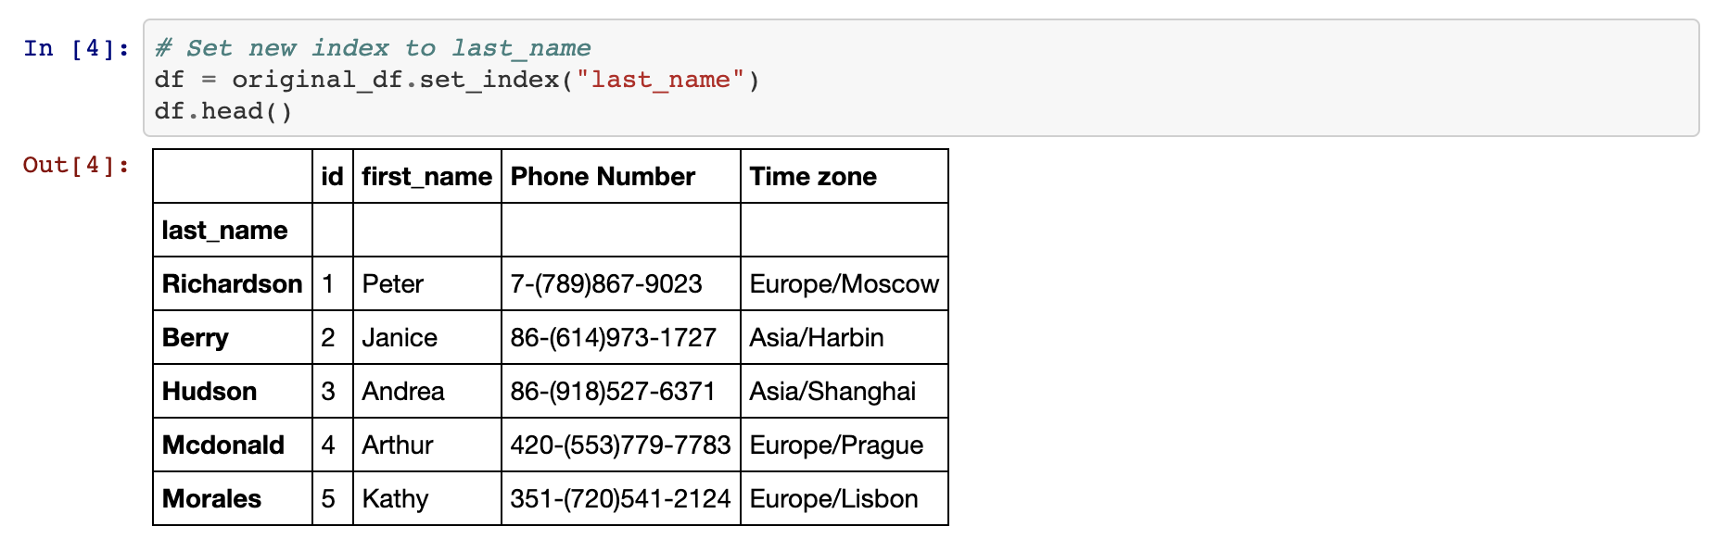
Exploring Data With Loc and Iloc
One of The Most Powerful Aspects of Pandas…
The loc() method returns data based upon an index of labels/strings
loc() is limited to string types and cannot be used on a numerical index. As an alternative solution you can use the df.set_index() function passing in the desired column header for the index.
On the other hand the iloc() method instead of using labels, it uses integer based indexing for selection by position.
Notes:
1.2
One of the most powerful aspects of Pandas is how easily programmers can collect specific rows/columns of data from a DataFrame using the loc() and iloc() methods.
The loc() method allows its users to select data using label based indexes. In other words, it takes in strings as the keys and returns data based upon that.
Using loc() to search through rows is only really useful when the index of a dataset is a collection of strings. It is almost always useful when selecting data from columns, however, since column headers are exclusively strings. This can be done by using the df.set_index() function and passing in the desired column header for the index.
The iloc() method also allows its users to select data, but instead of using labels, it instead uses integer based indexing for selection by position. In other words, it selects data in much the same way as one would select data from within a list; using a numeric index.

Slide 6
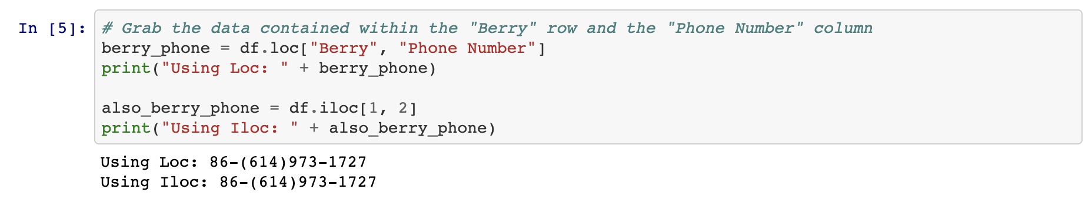
Exploring Data With Loc and Iloc
Both loc() and iloc() methods use brackets which contain the desired rows, followed by a comma, and then the columns desired.
For example:
loc[‘Berry’, ‘Phone Number’] or iloc[1,2]
Notes:
1.2
The typical way in which data is called using both loc[] and iloc[] is by using a pair of brackets which contain the rows desired, followed by a comma, and then the columns desired. For example: loc["Berry","Phone Number"] or iloc[1,2]

Slide 7
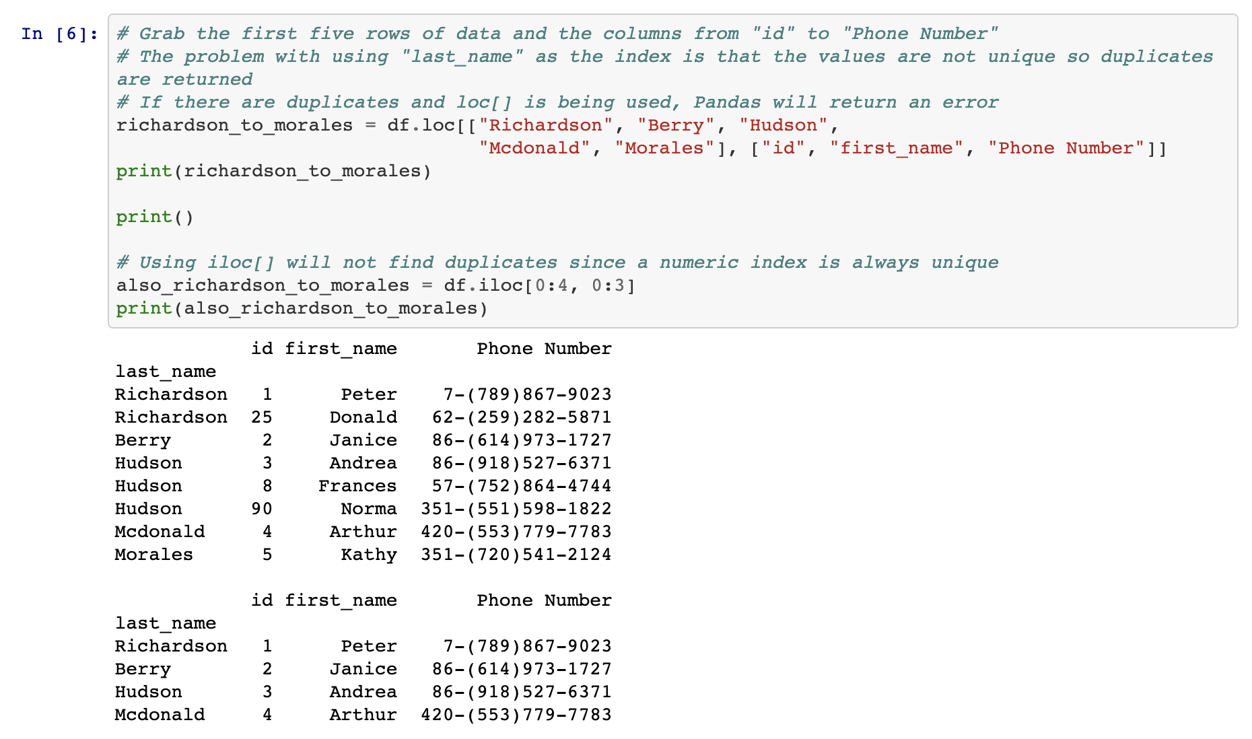
Exploring Data With Loc and Iloc
Both methods allow us to select a range of columns and rows by providing a list
We can also use a colon to tell Pandas to look for a range.
Notes:
1.2
It is also possible to select a range of data using loc[] and iloc[] by placing all of the values within brackets and/or using a colon to tell Pandas to look for a range. For example: loc[["Richardson", "Berry", "Hudson", "Mcdonald", "Morales"],["id", "first_name", "Phone Number"]] or iloc[0:4, 0:3]

Slide 8
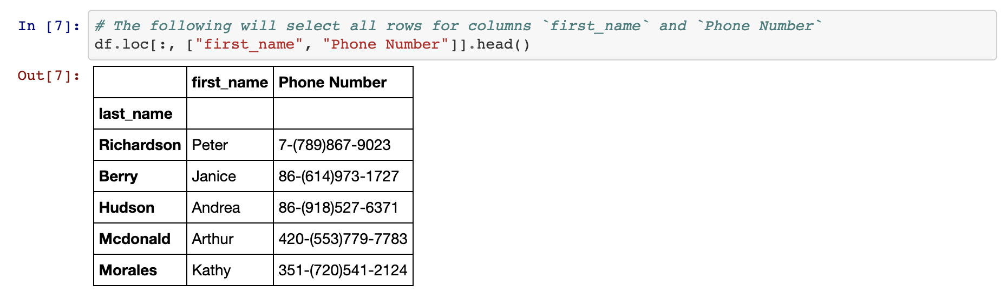
Exploring Data With Loc and Iloc
By passing in a colon by itself, loc() and iloc() will select all rows or columns depending on where it is placed in relation to the comma.
Notes:
1.2
By passing in a colon by itself, loc[] and iloc[] will select all rows or columns depending on where it is placed in relation to the comma. For example: loc[:, ["first_name", "Phone Number"] will select all rows of data but will only return the "first_name" and "Phone Number" columns.

Slide 9
loc() and iloc() can be used to conditionally filter rows of data based upon the values within a column.
Notes:
1.2
Note to self: background slide from ‘data-03-3-python-deeper-dive’ slide 6, and Einstein from ‘SQLAlchemy Daya 3’ slide 8

Slide 10
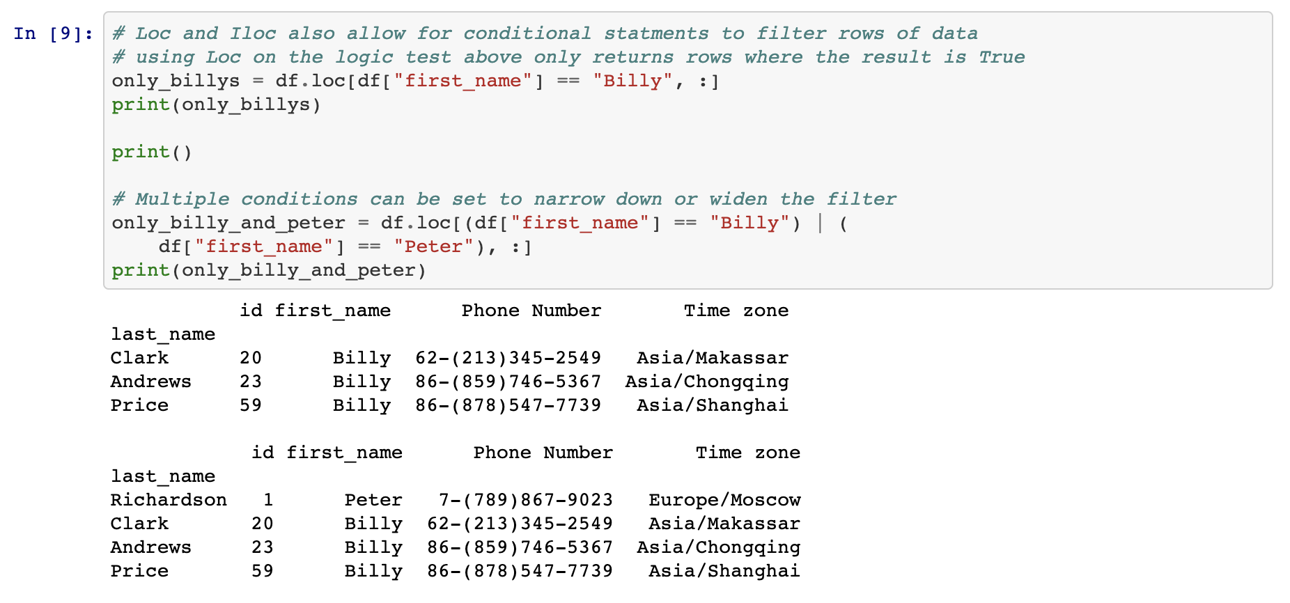
Exploring Data With Loc and Iloc
Instead of passing a list of indices, we can use a logic statement!
In case of multiple conditions that should be checked for, & and | may be added into logic test as representations of and and or.
Notes:
1.2
The way in which this is done is by calling loc[] or iloc[] on a DataFrame and passing a logic test in place of the rows section of the call. For example: loc[df["id"] >= 10, :] will return all rows of data with a value equal to or greater than 10 within the "id" column.
It is possible to then select which columns to return by simply adding their references into the columns section of the loc[] or iloc[] expression.
If there are multiple conditions that should be checked for, & and | may also be added into the logic test as representations of and and or. This allows for a great amount of customization.

Slide 11
Activity: Good Movies
In this activity, you will create an application that looks through IMDB data in order to find only the best movies out there.
20 Minutes
Notes:
1.3

Slide 12
Activity: Good Movies
Instructions:
Use Pandas to load and display the CSV provided in Resources.
List all the columns in the data set.
We're only interested in IMDb data, so create a new table that takes the Film and all the columns relating to IMDB.
Filter out only the good movies—i.e., any film with an IMDb score greater than or equal to 7 and remove the norm ratings.
Find less popular movies that you may not have heard about - i.e., anything with under 20K votes.
Finally, export this file to a spreadsheet, excluding the index, so we can keep track of our future watchlist.
Notes:
1.3

Slide 13
Notes:
1.4
Check lesson plan to review! Or see below:
Open 02-Stu_GoodMovies and walk through the code with the class, answering whatever questions students have.
Some key tidbits of information to cover during this review:
Since the user is only interested in data that pertains to IMDB, all rows that contain review information outside of IMDB are filtered out manually by simply dropping those rows.
In order to collect those films with a score greater than or equal to 7, a conditional loc[] filter is used that looks into the "IMDB" column and only collects those rows that pass through the logic test with a True value.
In order to collect those films that have less than 20K votes, another conditional loc[] filter is used that searches through the "IMDB_user_vote_count" column and only collects those rows that pass through the logic test with a True value.

Slide 14
Cleaning Data
Notes:
2.1

Slide 15
When dealing with massive datasets it is almost inevitable that duplicate rows, inconsistent spelling, and missing values will crop up.
Notes:
2.1
Note for instructor: Make sure to tell the students the
points below:
When dealing with massive datasets it is almost inevitable that duplicate rows, inconsistent spelling, and missing values will crop up.
While these issues may not seem significant in the grand scheme of things, they can severely hinder the analysis and visualization of a dataset by skewing the data one way or another.
Thankfully Pandas includes methods through which its users can remove missing values, replace duplicates, and change values with relative ease.
Note to self: background slide from ‘data-03-3-python-deeper-dive’ slide 6, and Einstein from ‘SQLAlchemy Daya 3’ slide 8

Slide 16
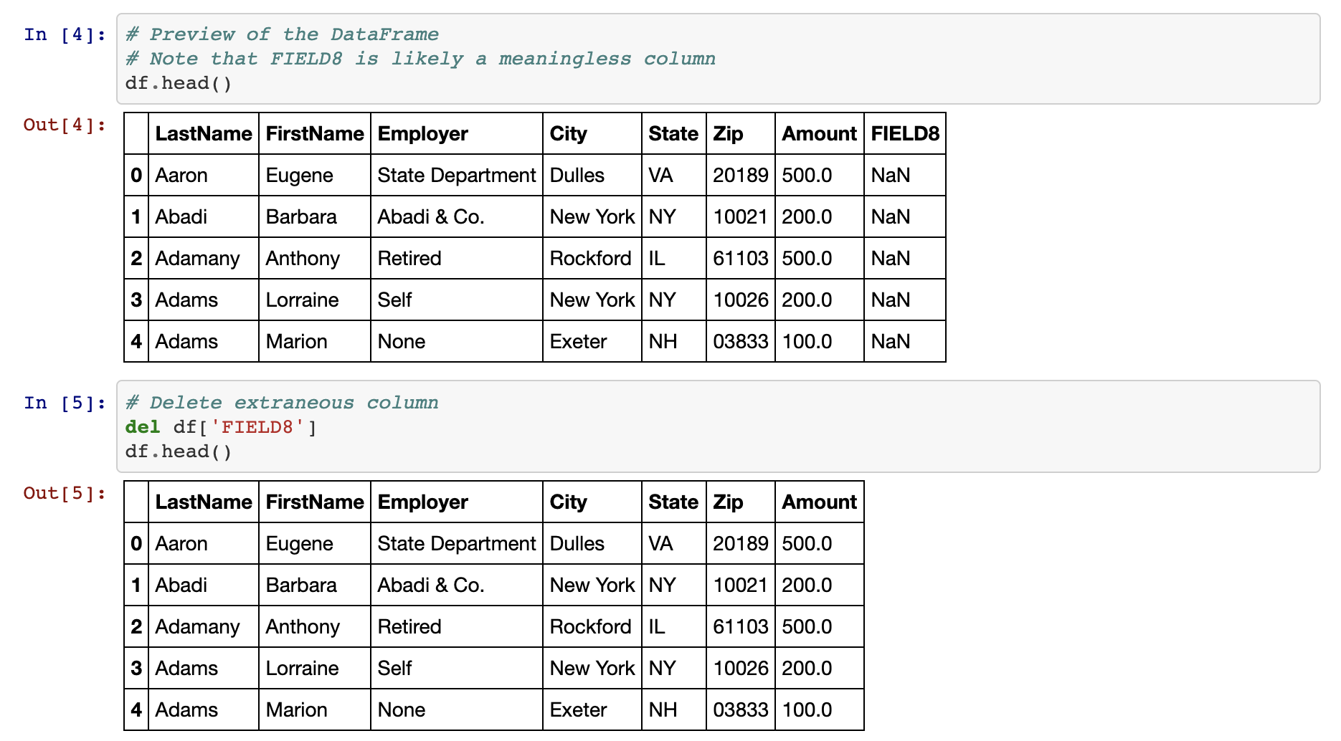
Cleaning Data
del <DataFrame>[<columns>]
Notes:
2.1
NOTE: slide referent to the highlighted bullet point.
Open up 03-Ins_CleaningData within Jupyter Notebook and run through the code line-by-line with the class.
In order to delete a column of extraneous information from a DataFrame: del <DataFrame>[<Column>]
In order to figure out if any rows are missing data, simply run the count() method on the DataFrame and check that all columns contain equal values.
In order to drop rows with missing information from a DataFrame: <DataFrame>.dropna(how="any")

Slide 17
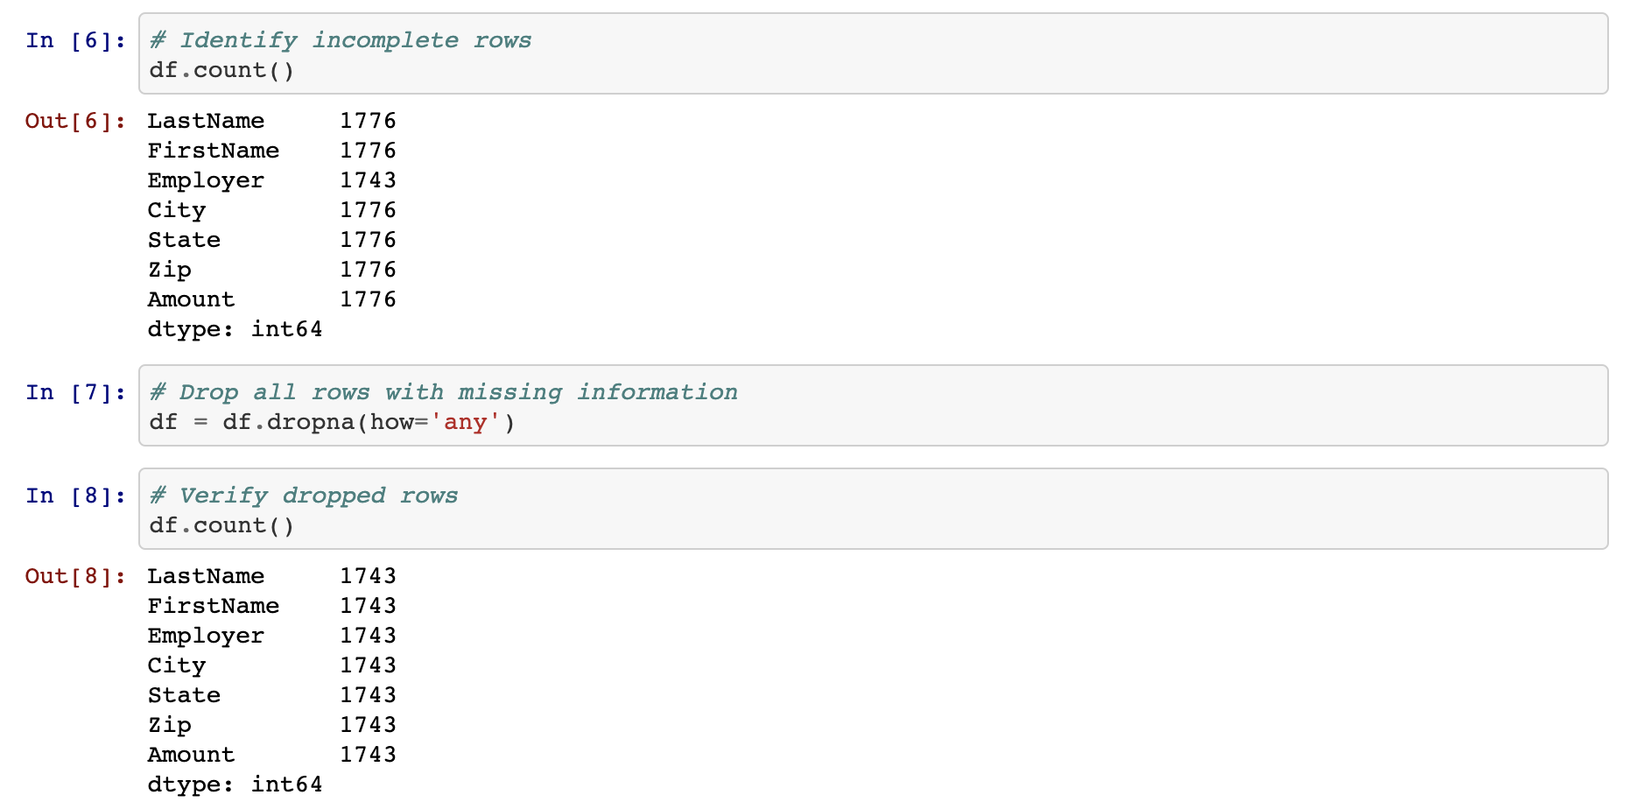
Cleaning Data
count()
<DataFrame>.dropna(how=’any’)
Notes:
2.1
NOTE: slide referent to the highlighted bullet point.
Open up 03-Ins_CleaningData within Jupyter Notebook and run through the code line-by-line with the class.
In order to delete a column of extraneous information from a DataFrame: del <DataFrame>[<Column>]
In order to figure out if any rows are missing data, simply run the count() method on the DataFrame and check that all columns contain equal values.
In order to drop rows with missing information from a DataFrame: <DataFrame>.dropna(how="any")

Slide 18
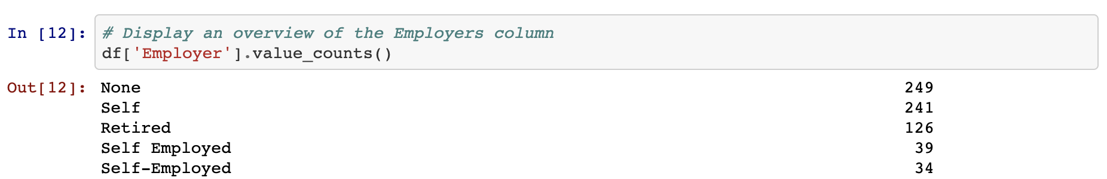
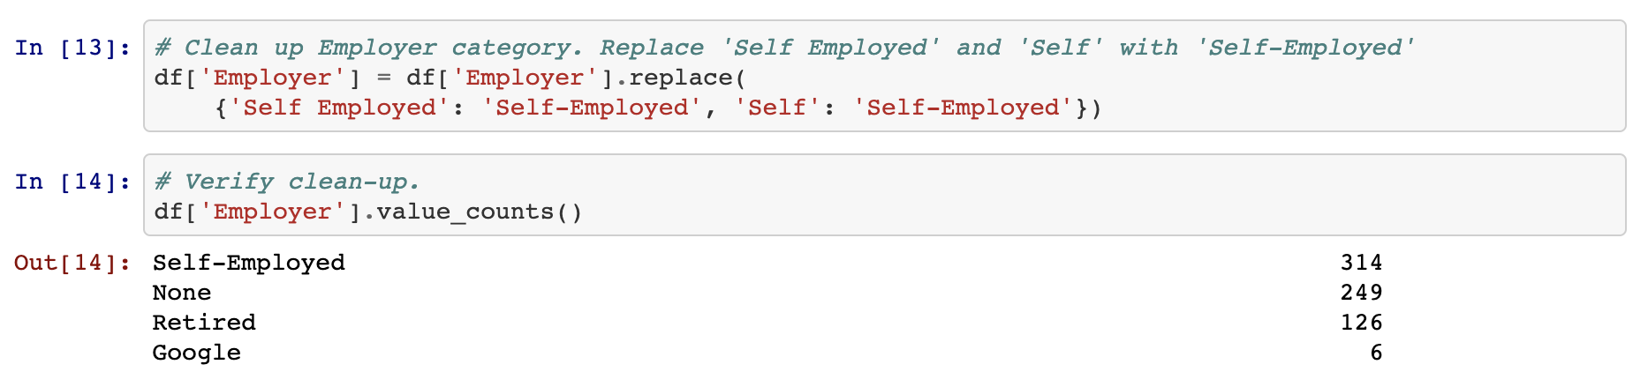
Cleaning Data
value_counts()
replace()
Notes:
2.1
Sometimes the rows containing "NaN" values should not be removed but should instead be filled with another value. In cases like these, simply using the <DataFrame>.fillna(value=<Value>) method and pass the value desired into the parentheses.
In order to find values that have similar/misspelled values, simply run the value_counts() method on the column in question and look through the values that are returned.
To replace similar/misspelled values, simply run the replace() method on the column in question and pass a dictionary into it with the keys being those values to replace and the value being those to replace the originals with.

Slide 19
Activity: Portland Crime
In this activity, you will take a crime dataset from Portland and do your best to clean it up so that the DataFrame is consistent and no rows with missing data are present.
20 Minutes
Notes:
2.2
Note: This is a partner activity

Slide 20
Activity: Portland Crime
Instructions:
Read in the csv using Pandas and print out the DataFrame that is returned.
Get a count of rows within the DataFrame in order to determine if there are any null values
Drop the rows which contain null values.
Search through the "Offense Type" column and replace any similar values with one consistent value.
Create a couple DataFrames that look into one Neighborhood only and print them to the screen.
Notes:
2.2
Note: This is a partner activity
Open up 04-Par_PortlandCrime within the Jupyter Notebook and run the code to show the end results of the application.

Slide 21
Notes:
2.3
Check lesson plan to review! Or see below:
Open 15-Par_PortlandCrime within the Jupyter Notebook and go over the solution briefly with students while answering any questions they have.

Slide 22
Activity: Pandas Recap and Data Types
In this activity, we will recap what has been covered in Pandas up to this point.
15 Minutes
Notes:
2.4

Slide 23

Activity: Pandas Recap and Data Types
Instructions:
Open up ‘PandasRecap.ipynb’ under the ‘unsolved’ folder in your Jupyter Notebook.
Go through the cells following the notes.
Hint:
A list of a DataFrame's data types can be seen by accessing its dtypes property.
In order to change a non-numeric column to a numeric column, use the df.astype(<datatype>) method and pass in the desired datatype as the parameter.
Notes:
2.4
REVIEW w/ JOE
Note: This is a everyone do activity
Open up and slack out the unsolved version of 05-PandasRecap along with ufoSightings.csv.
Go through the cells within the unsolved version of the Jupyter Notebook, having the class assist in creating the code that would accomplish the tasks listed within the comments.
If there is ever a moment in which your class seems to be struggling, feel free to refer to the solved version of 05-PandasRecap in order to help keep the class on track.
Disregard the "low-memory" warning produced after loading the csv. It is occurring because Pandas is analyzing the data type of each column.
Upon reaching the final cell, let the class know that this DataFrame has a small problem. The majority of the columns - even those that are purely numeric - are being stored as objects.
A list of a DataFrame's data types can be seen by accessing its dtypes property

Slide 24


Notes:
-------------------
Image source: AdobeStock_56885471

Slide 25
Pandas Grouping
Notes:
3.1

Slide 26
.groupby() is a simpler method to filter data.
Notes:
3.1
In the last activity, the class created a DataFrame which contained the sum of UFO sightings in each state. This acted as a summary table but does not include other interesting data point. For example: It does not contain the number of seconds UFOs were sighted for within each state.
While it would be possible to collect and calculate the sum of seconds for each state through the ample use of .loc[] filtering, there is a far simpler method that would cut down on time immensely.

Slide 27
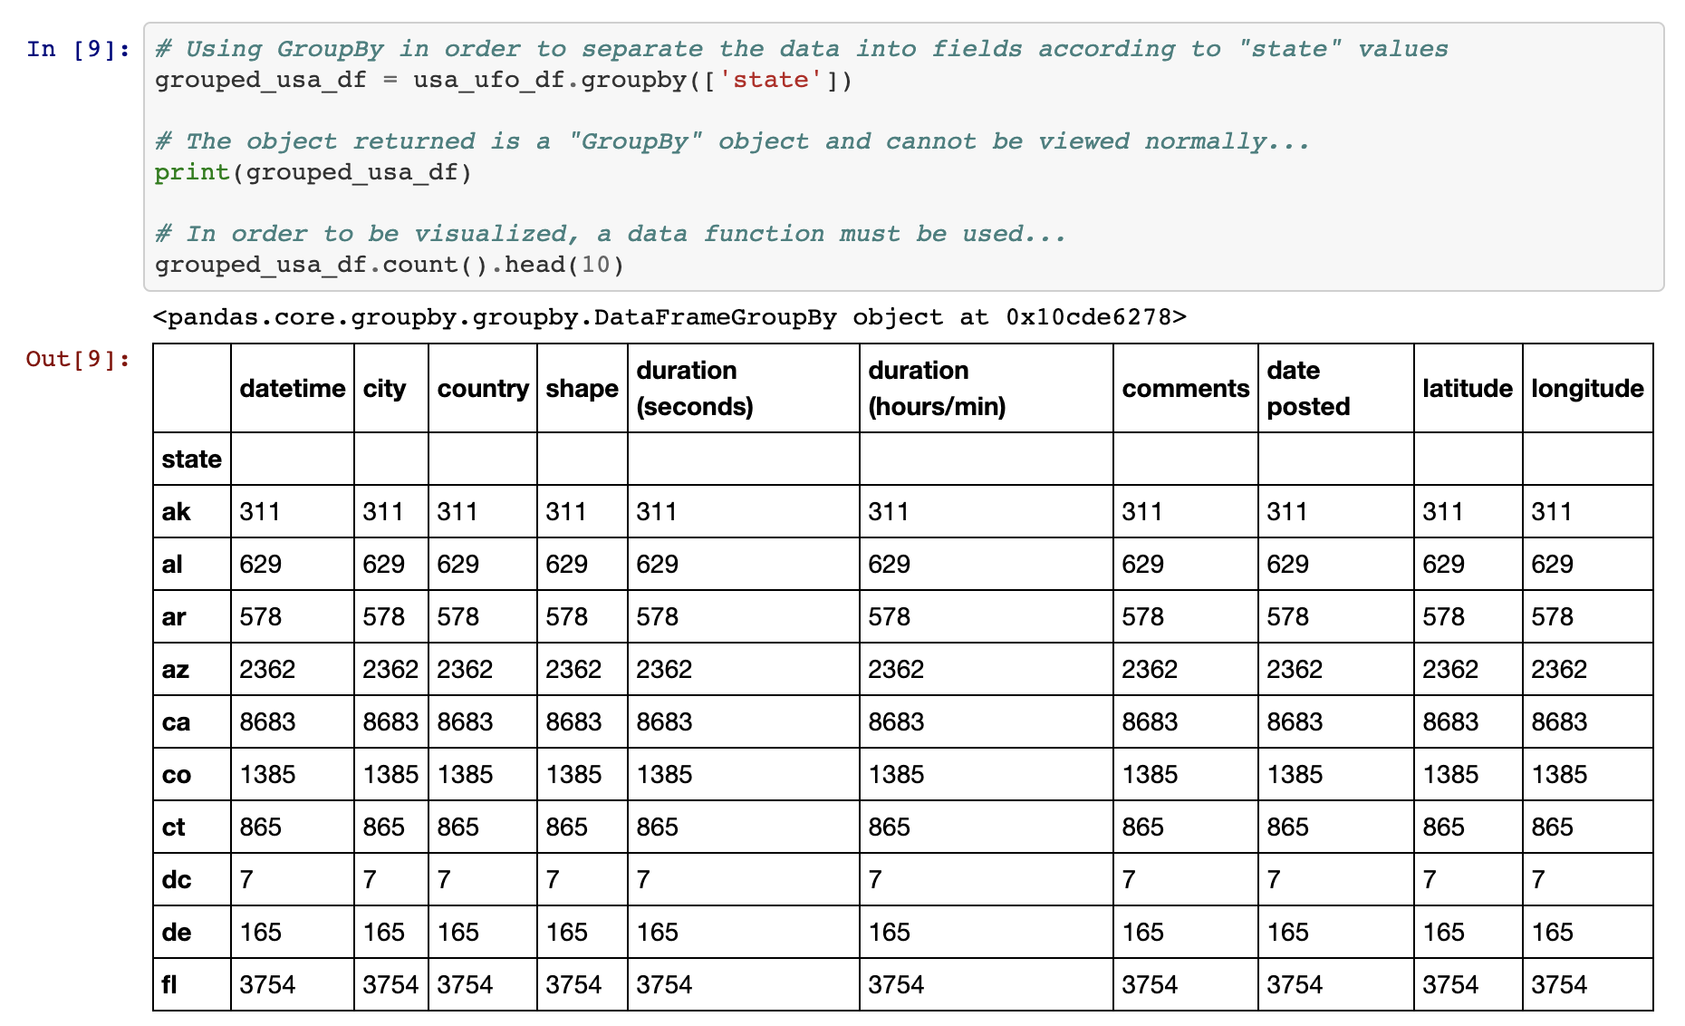
Pandas Grouping
In order to split the DataFrame into multiple groups and group by state the df.groupby([<Columns>]) is used.
The .groupby() method returns a GroupBy object that can only be access by using a data function on it.
Notes:
3.1
Open up 06-Ins_GroupBy within Jupyter Notebook and run through the code with the class, explaining it cell-by-cell.
The start of the code is much the same as earlier. Import in dependencies, remove all rows with missing data, convert the "duration (seconds)" column to numeric, filter the DataFrame so only US info is shown, and count the number of sightings per state.
The df.groupby([<Columns>]) method is then used in order to split the DataFrame into multiple groups with each group being a different state within the US.
The object returned by the .groupby() method is a GroupBy object and cannot be accessed like a normal DataFrame. In fact, one of the only ways in which to access values within a GroupBy object is by using a data function on it.

Slide 28
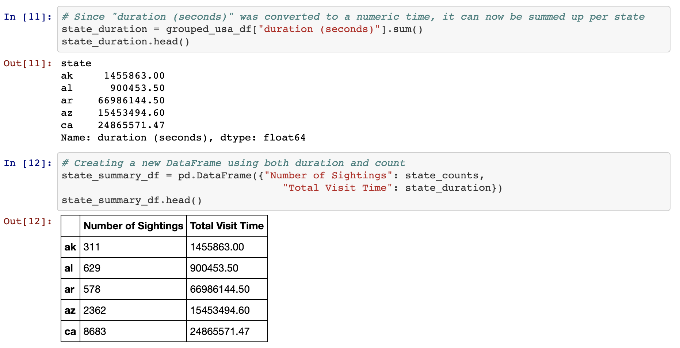
Pandas Grouping
The pd.DataFrame() method makes possible to create new DataFrames using solely GroupBy data.
A DataFrame can also be created by selecting a single series from a GroupBy object and passing it in as the values for a specified column.
Notes:
3.1
It is possible to create new DataFrames using purely GroupBy data. This can be done by taking the pd.DataFrame() method and passing the GroupBy data desired in as the parameter.
A DataFrame can also be created by selecting a single series from a GroupBy object and passing it in as the values for a specified column.

Slide 29
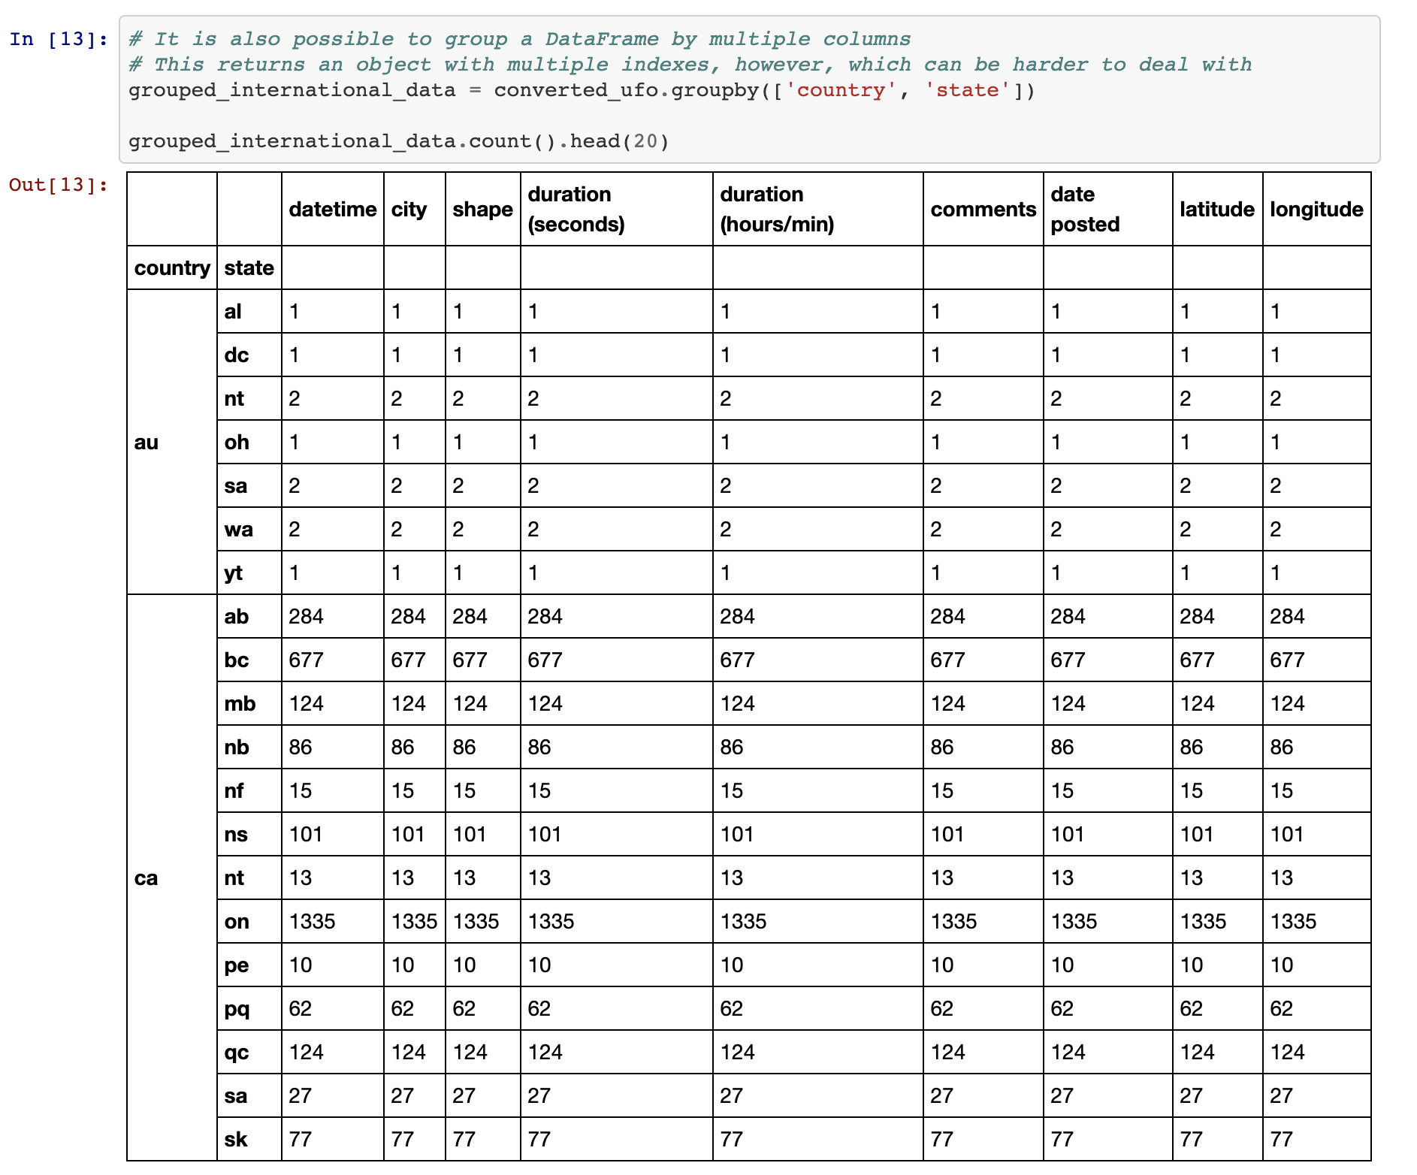
Pandas Grouping
It is possible to perform a df.groupby() method on multiple columns as well. This can be done by simply passing two or more column references into the list parameter.
Notes:
3.1
It is possible to perform a df.groupby() method on multiple columns as well. This can be done by simply passing two or more column references into the list parameter.

Slide 30
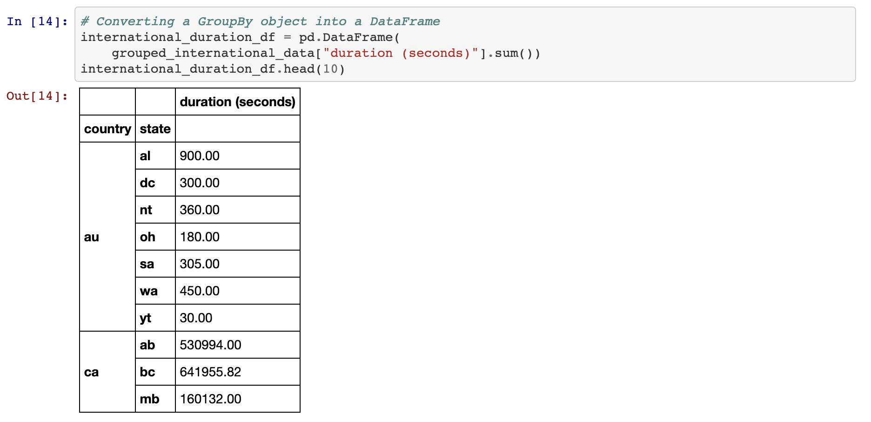
Pandas Grouping
A new DataFrame can be created from a GroupBy object.
Notes:
3.1

Slide 31
Activity: Building a PokeDex
In this activity, you will create a DataFrame that visualizes the average stats for each type of Pokemon from the popular video game series.
25 Minutes
Notes:
3.2

Slide 32
Activity: Pandas Recap and Data Types
Instructions:
Read the Pokemon CSV file with Pandas.
Create a new table by extracting the following columns: "Type 1", "HP", "Attack", "Sp. Atk", "Sp. Def", and "Speed".
Find the average stats for each type of Pokemon.
Create a new DataFrame out of the averages.
Calculate the total power level of each type of Pokemon by summing all of the previous stats together and place the results into a new column.
Bonus:
Sort the table by strongest type and export the resulting table to a new CSV.
Notes:
3.2
Note: This is a partner activity
Open up the solved version of 07-Par_Pokemon within Jupyter Notebook in order to show students what the final version of their application should look like.

Slide 33
Notes:
3.3
Check lesson plan to review! Or see below:
Open up the solved version of 07-Par_Pokemon within Jupyter Notebook and work through the code with the class, making certain to cover the following points...
The original dataset is read into a Pandas DataFrame and is then cut down so that only the "Type 1" and stat columns remain.
The DataFrame is then grouped according to the values contained within the "Type 1" column and the averages for each type are then calculated using the df.mean() method.
A new DataFrame is then created using the GroupBy object returned by pokemon_group.mean() and the totals for each type of Pokemon is calculated by adding up the values in each row before placing them into a newly created "Totals" column.
Answer whatever questions the class may have before moving onto the next activity.

Slide 34
Sorting Made Easy
Notes:
4.1
Within the last activity's bonus, students were asked to sort their final table by which type of Pokemon was strongest. While the solution to this problem could be uncovered rather simply through some applied "Google-Fu", there are some quirks to sorting which should be covered.

Slide 35
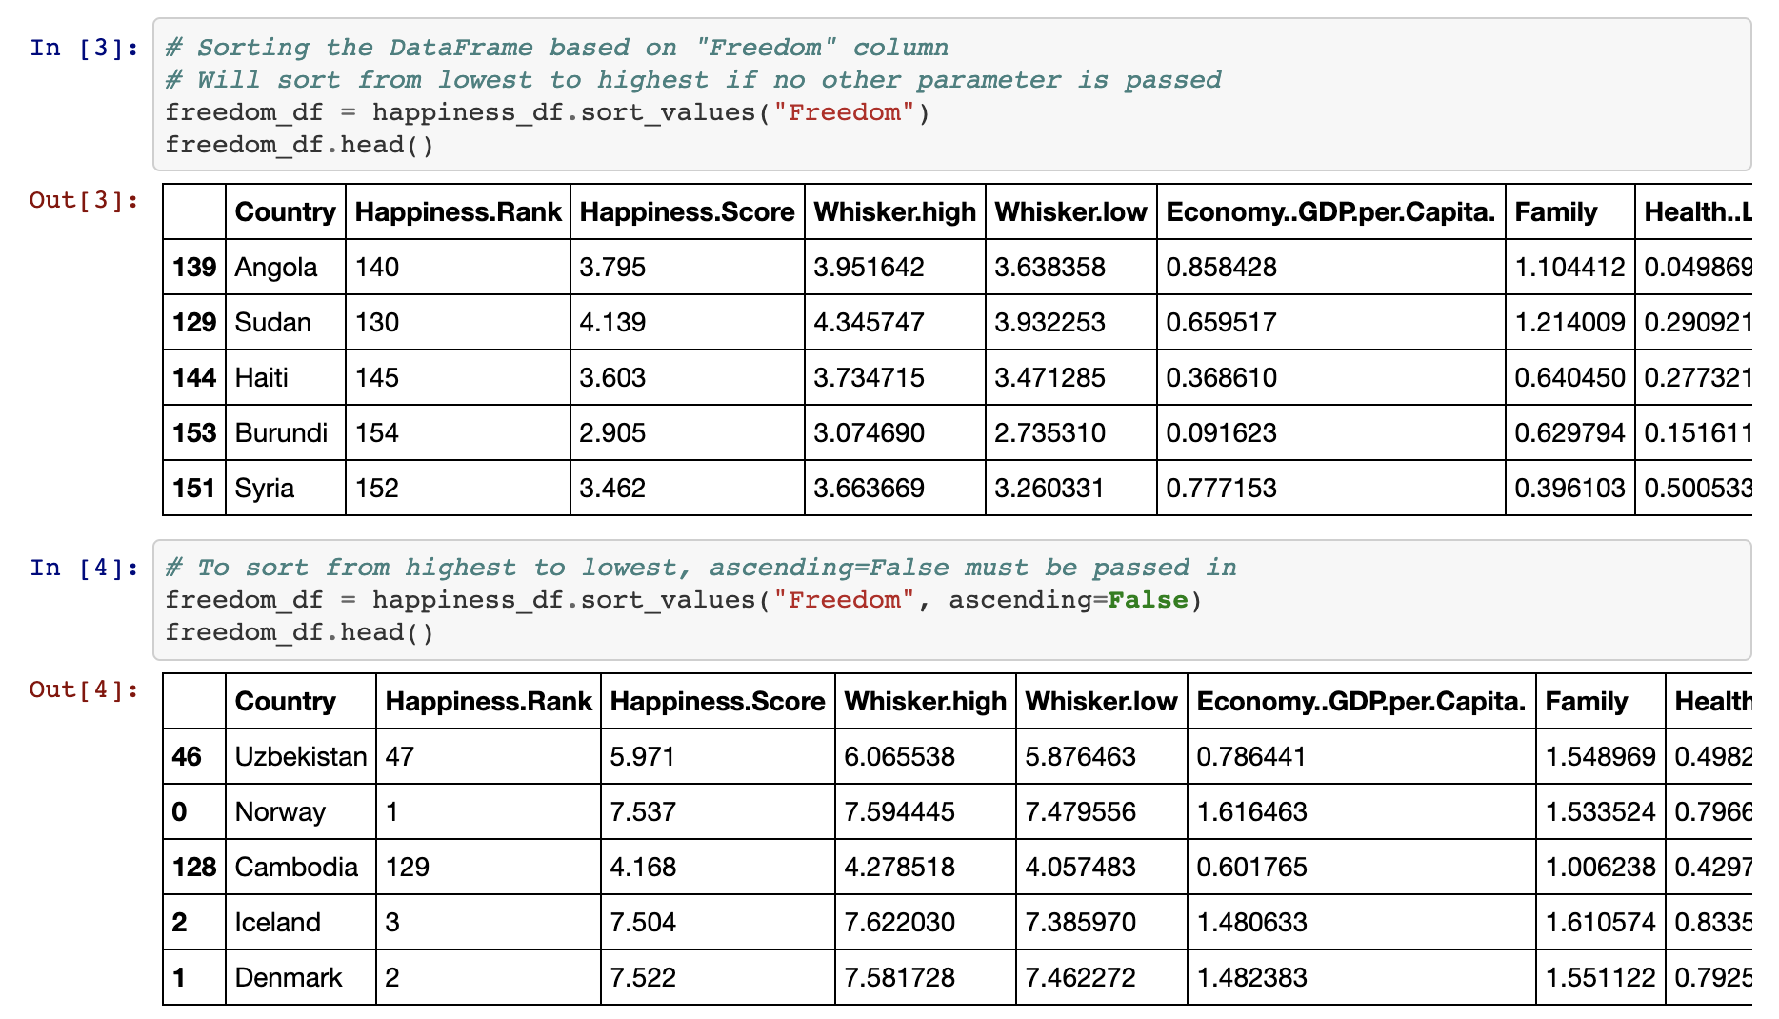
Sorting Made Easy
In order to sort a DataFrame based upon the values within a column, simply use the df.sort_values() method and pass the column name to sort by in as a parameter.
The parameter of "ascending" is always marked as True by default. This means that the sort_values() method will always sort from lowest to highest unless the parameter of ascending=False into passed into the sort_values() method as well.
Notes:
4.1
Open up 08-Ins_Sorting within Jupyter Notebook and run through the code with the class, discussing it cell-by-cell.
The data being used here is the 2017 world happiness rankings and, while they have already been sorted from most happy to least happy, it is possible to sort this dataset using the values in different columns.
In order to sort a DataFrame based upon the values within a column, simply use the df.sort_values() method and pass the column name to sort by in as a parameter.
The parameter of "ascending" is always marked as True by default. This means that the sort_vales() method will always sort from lowest to highest unless the parameter of ascending=False into passed into the sort_values() method as well.
Something immensely helpful when dealing with sorted DataFrames is the df.reset_index() method. This method will recalculate the index for each row based upon their position within the new DataFrame and, as such, will allow for far simpler referencing of rows in the future.
Passing drop=True into df.reset_index() will ensure no new column is created when the index is reset.
It is possible to sort based upon the values stored within multiple columns by passing a list of columns into the sort_values() method as a parameter. The first column will be the primary sorting method with ties being broken by the second column.

Slide 36
Activity: Search For the Worst
In this activity, you will take a dataset composed of soccer player statics and will attempt to determine which players are the worst in the world at their particular position.
25 Minutes
Notes:
4.2

Slide 37
Activity: Search For the Worst
Instructions:
Read in the CSV file provided and print it to the screen.
Print out a list of all of the values within the "Preferred Position" column.
Select a value from this list and create a new DataFrame that only includes players who prefer that position.
Sort the DataFrame based upon a player's skill in that position.
Reset the index for the DataFrame so that the index is in order.
Print out the statistics for the worst player in a position to the screen.
Notes:
4.2
Open up the solved version of 09-Stu_SearchForTheWorst within Jupyter Notebook in order to show students what the final version of their application should look like.

Slide 38
Notes:
4.3
Check lesson plan to review! Or see below:
Open up 09-Stu_SearchForTheWorst within Jupyter Notebook and run through the code with the class, discussing it cell-by-cell.
To collect a list of all the positions players prefer to play in, the unique() method is run on the "Preferred Position" column within the DataFrame.
To filter in only those players that play in a particular position, use df.loc() and have it collect only those rows where "Preferred Position" is equal to the position desired.
To sort the values within the new DataFrame from lowest to highest, simply run the df.sort_values() method, pass the position column to sort by, and then make sure that ascending = True. This final step should be completed by default without having to be entered.

